Slide 1


Green Pace
Security Policy Presentation
Developer: Daniel Tipton

Slide 2

OVERVIEW: DEFENSE IN DEPTH
Defense in Depth refers to making sure that security is a priority and has multiple layers to ensure the best possible protection for the company.

Slide 3
THREATS MATRIX
The following are the major code standards rankings according to how likely it’s to happen. I will be going over these in depth in the next slides.
Likely STD-003, STD-004, STD-005, STD-006 STD-010 | Priority All
Low priority STD-007 STD-002 STD-009 | Unlikely STD-001 STD-008

Slide 4
10 PRINCIPLES
1. Validate Input Data – STD-001-CPP, STD-002-CPP, STD-003-CPP, STD-004-CPP, STD-010-CPP
2. Heed Compiler Warnings - STD-001-CPP, STD-002-CPP, STD-005-CPP
3. Architect and design for Security Policies – STD-004-CLG, STD-007-CPP, STD-009-CPP
4. Keep it Simple – STD-001-CPP, STD-009-CPP
5. Default Deny
6. Adhere to the Principle of Least Privilege
7. Sanitize Data Sent to Other Systems – STD-003-CPP, STD-004-CPP
8. Practice Defense in Depth – STD-001-CPP, STD-002-CPP, STD-003-CPP, STD-008-CPP, STD-009-CPP
9. Use Effective Quality Assurance Techniques – STD-005-CPP, STD-006-CPP, STD-007-CPP, STD-010-CPP
10. Adopt a Secure Coding Standard – STD-008-CPP

Slide 5
CODING STANDARDS
1. STD-002-CPP: Expressions and the rules surrounding the use of them.
2. STD-003-CPP: Integers rules for dealing with signed and unsigned int values.
3. STD-004-CPP: Containers rules surrounding object containers
4. STD-005-CPP: Characters and Strings rules for handling strings and c-strings
5. STD-009-CPP: Object Oriented Programming rules for proper oop
6. STD-010-CPP: Concurrency rules dealing with Concurrency ( ie threads)
7. STD-006-CPP: Memory Management rules dealing with memory
8. STD-001-CPP: Declarations and Initialization rules for declaring values
9. STD-007-CPP: Input Output rules dealing with program input and output
10. STD-008-CPP: Exceptions and Error Handling rules for proper implementation of exceptions and error handling.

Slide 6
ENCRYPTION POLICIES
In Rest – Protects the data where it is stored. This could be on a computer, phone, database, or cloud. Uses tools such as VeraCrypt or AxCrypt. Keeps data from being physically, logically, or breached any other way
At Flight – Protects data as it’s moved from one location to another. This would be things like your emails. This would also include protective networks on both offices and remote workers ( using vpns and such).
In Use – Protects data as it’s being accessed or created. This is the in between state of the other two policies. There are a variety of system tools and operating system tools to implement this.

Slide 7
TRIPLE-A POLICIES
Authentication – Authentication verifies who a user is. This can take the form of passwords, SSO systems, biometrics, etc.
Authorization – Authorization is a system of permissions to access data. It’s important that we only allow as little permission as possible to accounts so that data is protected.
Accounting - This would be the logging of interactions with our systems and our data.

Slide 8
Unit Testing
The following are Unit test that test different properties of a collections object. This will show a variety of examples on how unit test work and why they are effective.

Slide 9
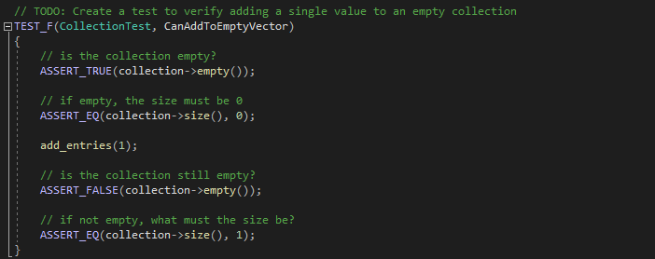
Verify adding a single value to a collection
The test here verifies that a value can be added to an empty collection.
This could be added on by adding different entries, or values.

Slide 10
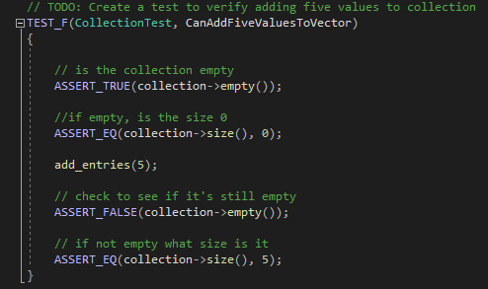
Verify Adding Five Values to a Collection
Building off the last test this does exactly that by adding 5 entries.
This could be further tested by adding multiples other than 5.

Slide 11
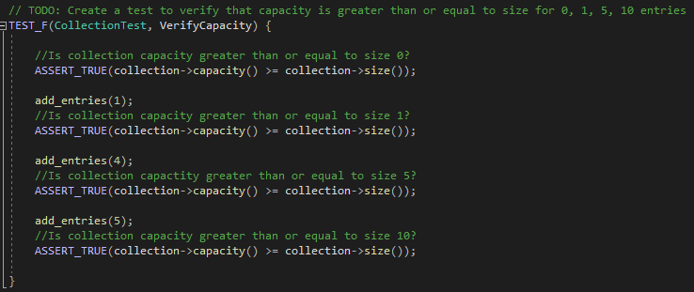
Verify the capacity is greater than or equal to the number of entries
This tests that the capacity is greater than or equal to the size. Unit test can be used in a variety of ways.
A way to take this further would be to test for paritial values.

Slide 12
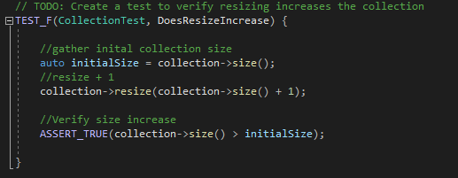
Verify Resizing Increases the collection
This test verifies that the size property of the collection is resizable.
Another test that could be performed is the ability to shrink the collection.

Slide 13
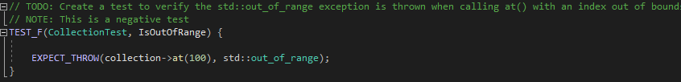
Verify the std::out_of_range exception is thrown when an index is out of bounds.
The following shows a negative test. It’s testing to make sure that exceptions are working and picking up errors.

Slide 14

AUTOMATION SUMMARY

Slide 15
TOOLS
The DevSecOps pipeline is integrating security measures into each step of the DevOps toolchain. This will allow security to become an important and key part in an ever growing technological world. This will also make sure that the company is as protected as possible from outside threats.
There are a variety of tools that can be used to help with providing security coverage. Google Testing framework for unit testing c++ applications for instance. CPPChecker for static code analysis. These are just a few of the software tools for development, but there are many more protocols and hardware based security tools that can help ensure that company data is kept private.

Slide 16
RISKS AND BENEFITS
There are numerous benefits associated with adopting a security first approach. For one consumer confidence. Consumers knowing that using your systems will not risk there personal data getting out into the world.
As for Risk there are an unmeasurable amount of risk not adopting a security policy. Just having a password system isn’t enough. For instance the yahoo attack that affected over 400 million users comes to mind. With cyber attacks becoming a daily occurrence it’s imperative to increase security.

Slide 17
RECOMMENDATIONS
I recommend a few places that we can start with security.
1. Check all complier errors in code and run the code through a static code analysis program. This will allow us to see what the risk in the code are and what we can do to fix this.
2. Make sure that we are keeping up with critical security patches. These are very important as soon as a day one vulnerability is announced hackers will know how to attack your systems.
3. Enact account authorization and authentication. That way we can make sure one persons account being hacked doesn’t compromise the entire system.
4. Security training for all employees. Let them know the dangers and how to be aware of common attacks ( such as email spoofing
By starting with the 4 above we can start making an positive impact in your company. Overall we need to fully adopt a security first policy, but that we take time to fully implement. In the meantime insuring that we are making constant progress is important.

Slide 18
CONCLUSIONS
Defense in Depth – This is a must, having multiple layers of coverage will help prevent attacks and mitigate slight attacks
DevSecOps – Moving to a DevSecOps model will help to ensure that security is a priority in all rollouts and development.
Authentication and Authorization – Making sure you validate who uses the systems and what can access are very important for protecting data
Tools – Make good use of third party tools to help supplement your own internal security ( ie don’t build your own encryption).
Priority – Make security a priority so that the business can continue and grow.

